Slide 1
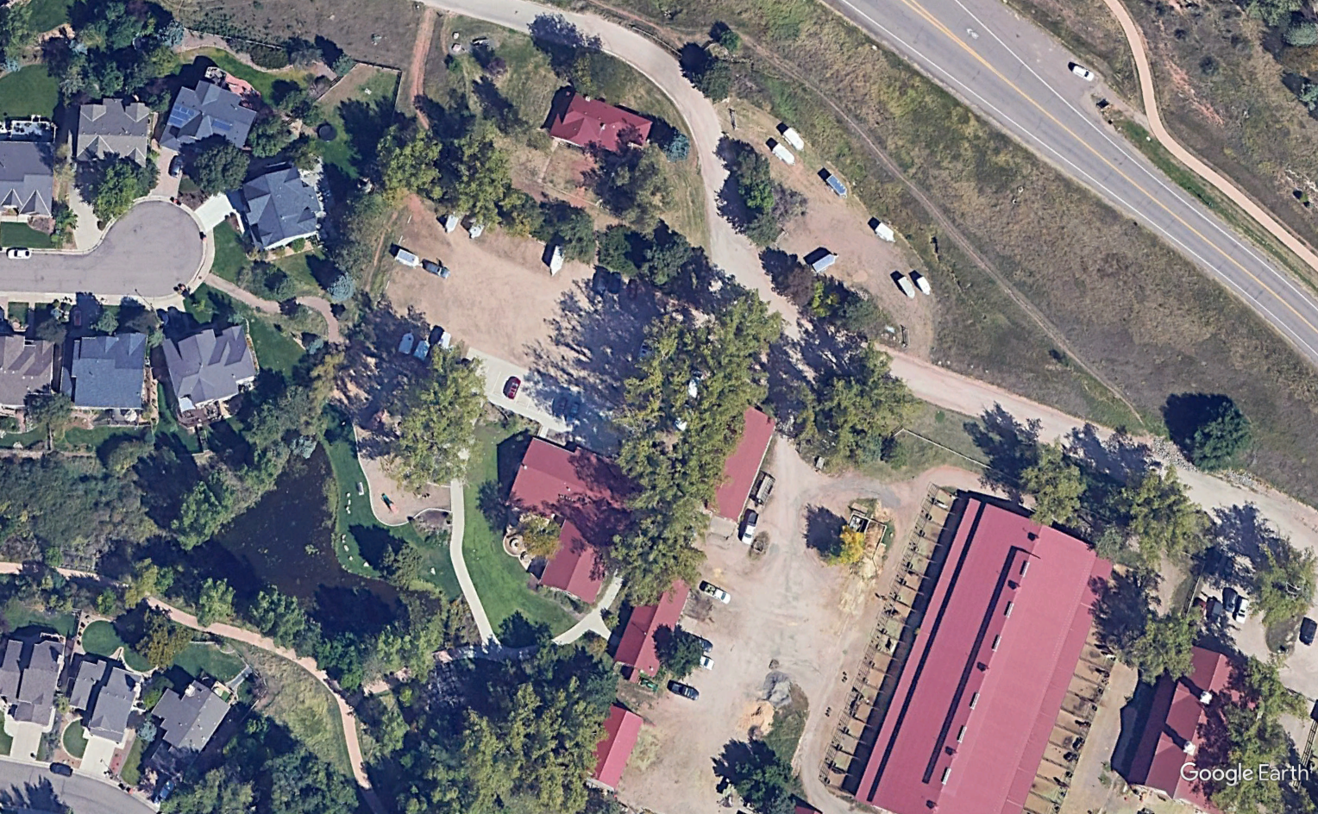
*New Ranger Office
Dakota Lodge
Past Ranger Office

